Slide 1

Yachay.ai
Geolocation Predictions Based on Tweets

Slide 2
Project Design
Preprocessing
Get embeddings using pretrained Hugging Face model
Training Base Model
Train neural network on embeddings to get base model performance
Datetime Features
Feature engineer from datetime features
NLP Features
Final Model
Train final model on embeddings + new features
Feature engineer from NLP pipelines: sentiment, language, ner, and topic

Slide 3

Preprocessing
Using XLM RoBERTa Large

Slide 4

XLM RoBERTa Large
XLM-RoBERTa is a multilingual version of RoBERTa.
It is pre-trained on 2.5TB of filtered CommonCrawl data containing 100 languages.
Pretrained on a large corpus in a self-supervised fashion.
Notes:
Picked because pretrained on 100 languages

Slide 5
Hugging Face Pipelines
Extracting Features from Text

Slide 6
NLP Feature Exraction
Language Chart
NER Chart
ivanlau/language-detection-fine-tuned-on-xlm-roberta-base
This model is a fine-tuned version of xlm-roberta-base on the common language dataset.
Arabic, Basque, Breton, Catalan, Chinese (China), Chinese (Hongkong), Chinese (Taiwan), Chuvash, Czech, Dhivehi, Dutch, English, Esperanto, Estonian, French, Frisian, Georgian, German, Greek, Hakha Chin, Indonesian, Interlingua, Italian, Japanese, Kabyle, Kinyarwanda, Kyrgyz, Latvian, Maltese, Mongolian, Persian, Polish, Portuguese, Romanian, Romansh Sursilvan, Russian, Sakha, Slovenian, Spanish, Swedish, Tamil, Tatar, Turkish, Ukrainian, Welsh
Abderrahim2/bert-finetuned-Location
This model is a fine-tuned version of dbmdz/bert-base-french-europeana-cased on an unknown dataset.
Notes:
Used pipelines to see if model score improved
Picked language pipeline for training on 40 common languages
NER did not work as planned, pick a better model

Slide 7
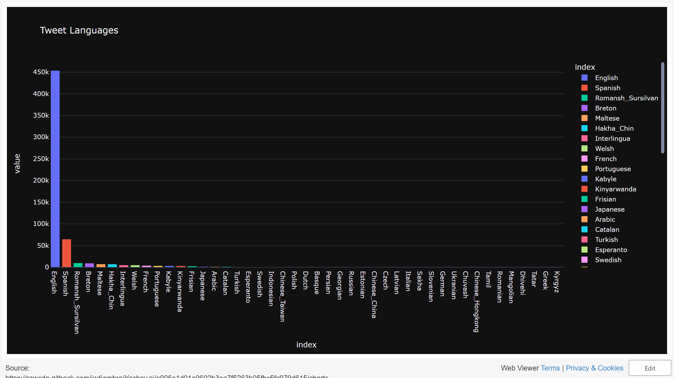

Slide 8
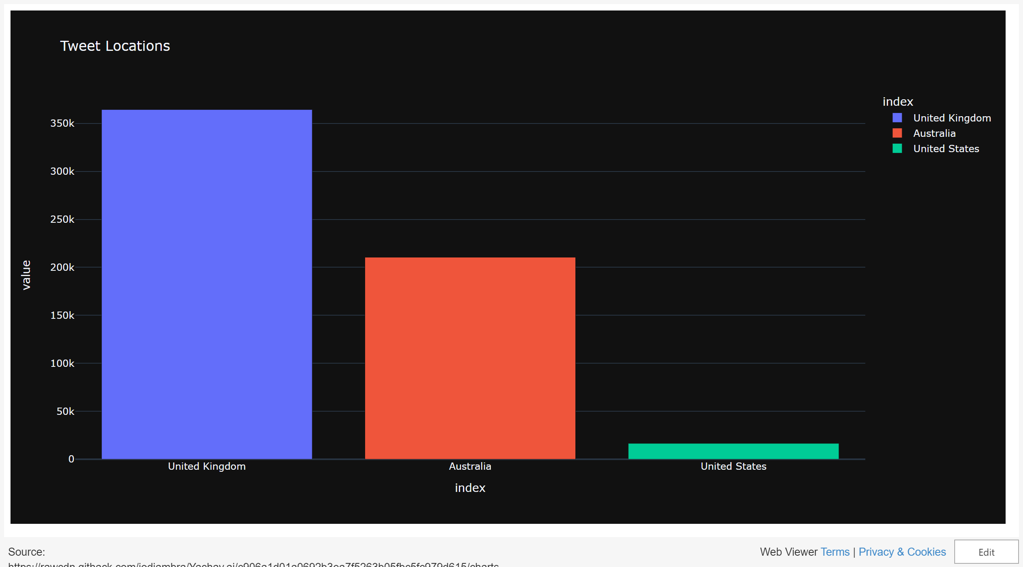

Slide 9
NLP Feature Exctraction Cont.
Sentiment Chart
Topics Chart
cardiffnlp/twitter-xlm-roberta-base-sentiment
This is a multilingual XLM-roBERTa-base model trained on ~198M tweets and finetuned for sentiment analysis
The sentiment fine-tuning was done on 8 languages (Ar, En, Fr, De, Hi, It, Sp, Pt)
jonaskoenig/topic_classification_04
This model is a fine-tuned version of microsoft/xtremedistil-l6-h256-uncased on an unknown dataset.
Notes:
Sent pipeline chosen for fine tuning on 8 languages

Slide 10
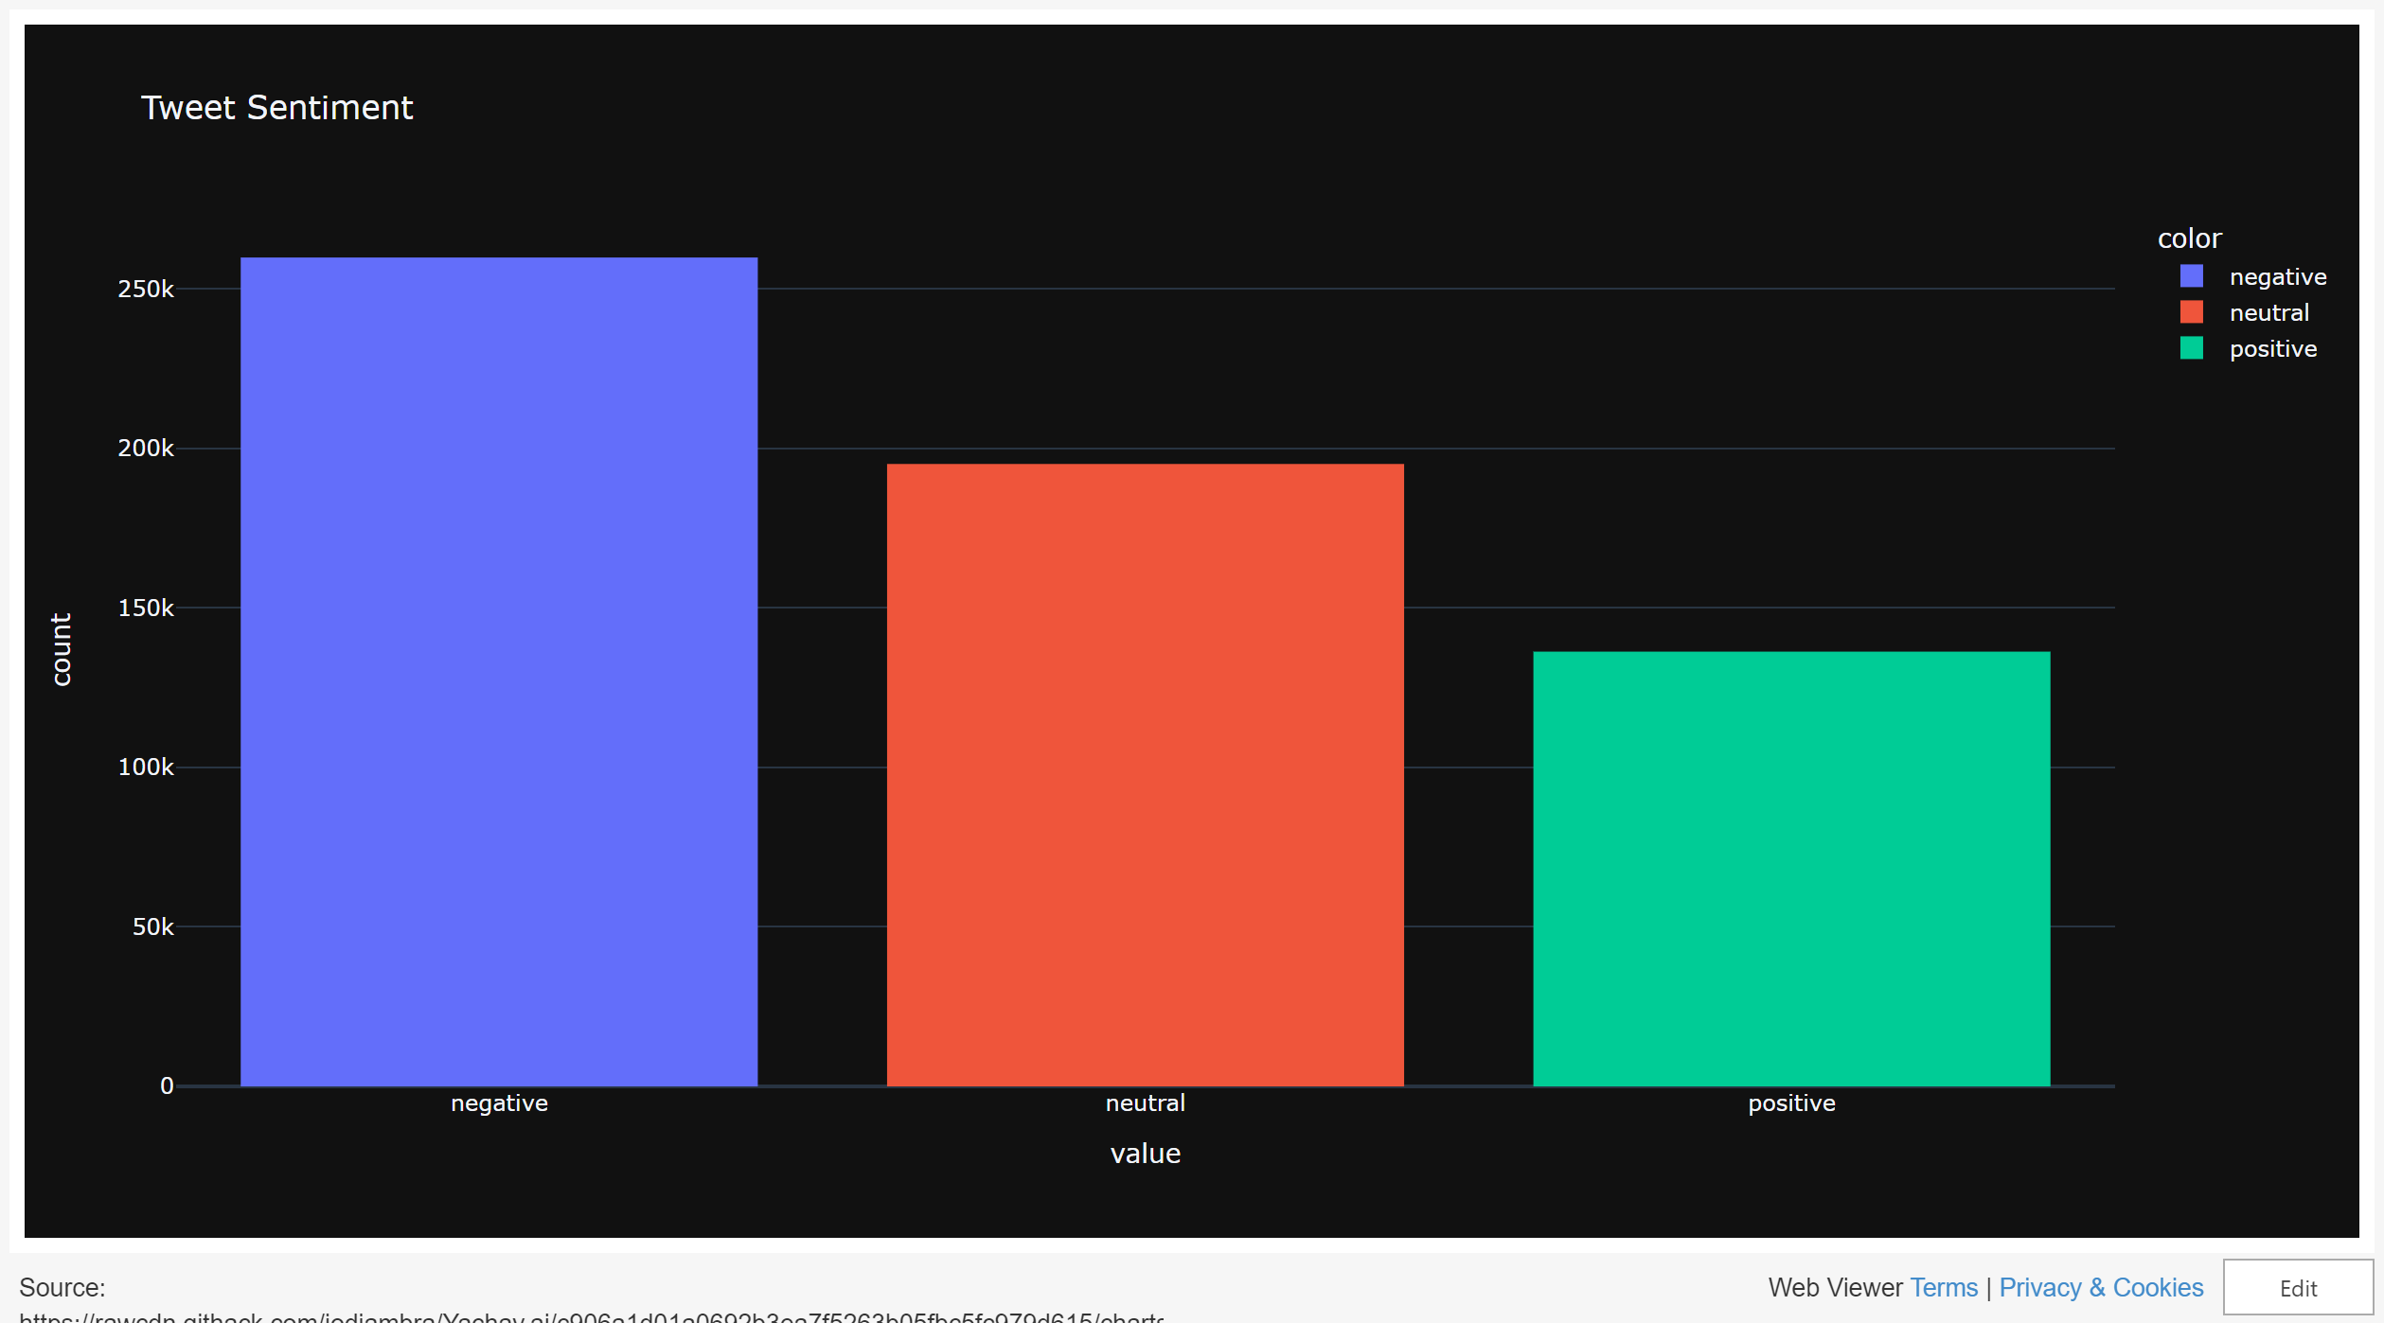

Slide 11
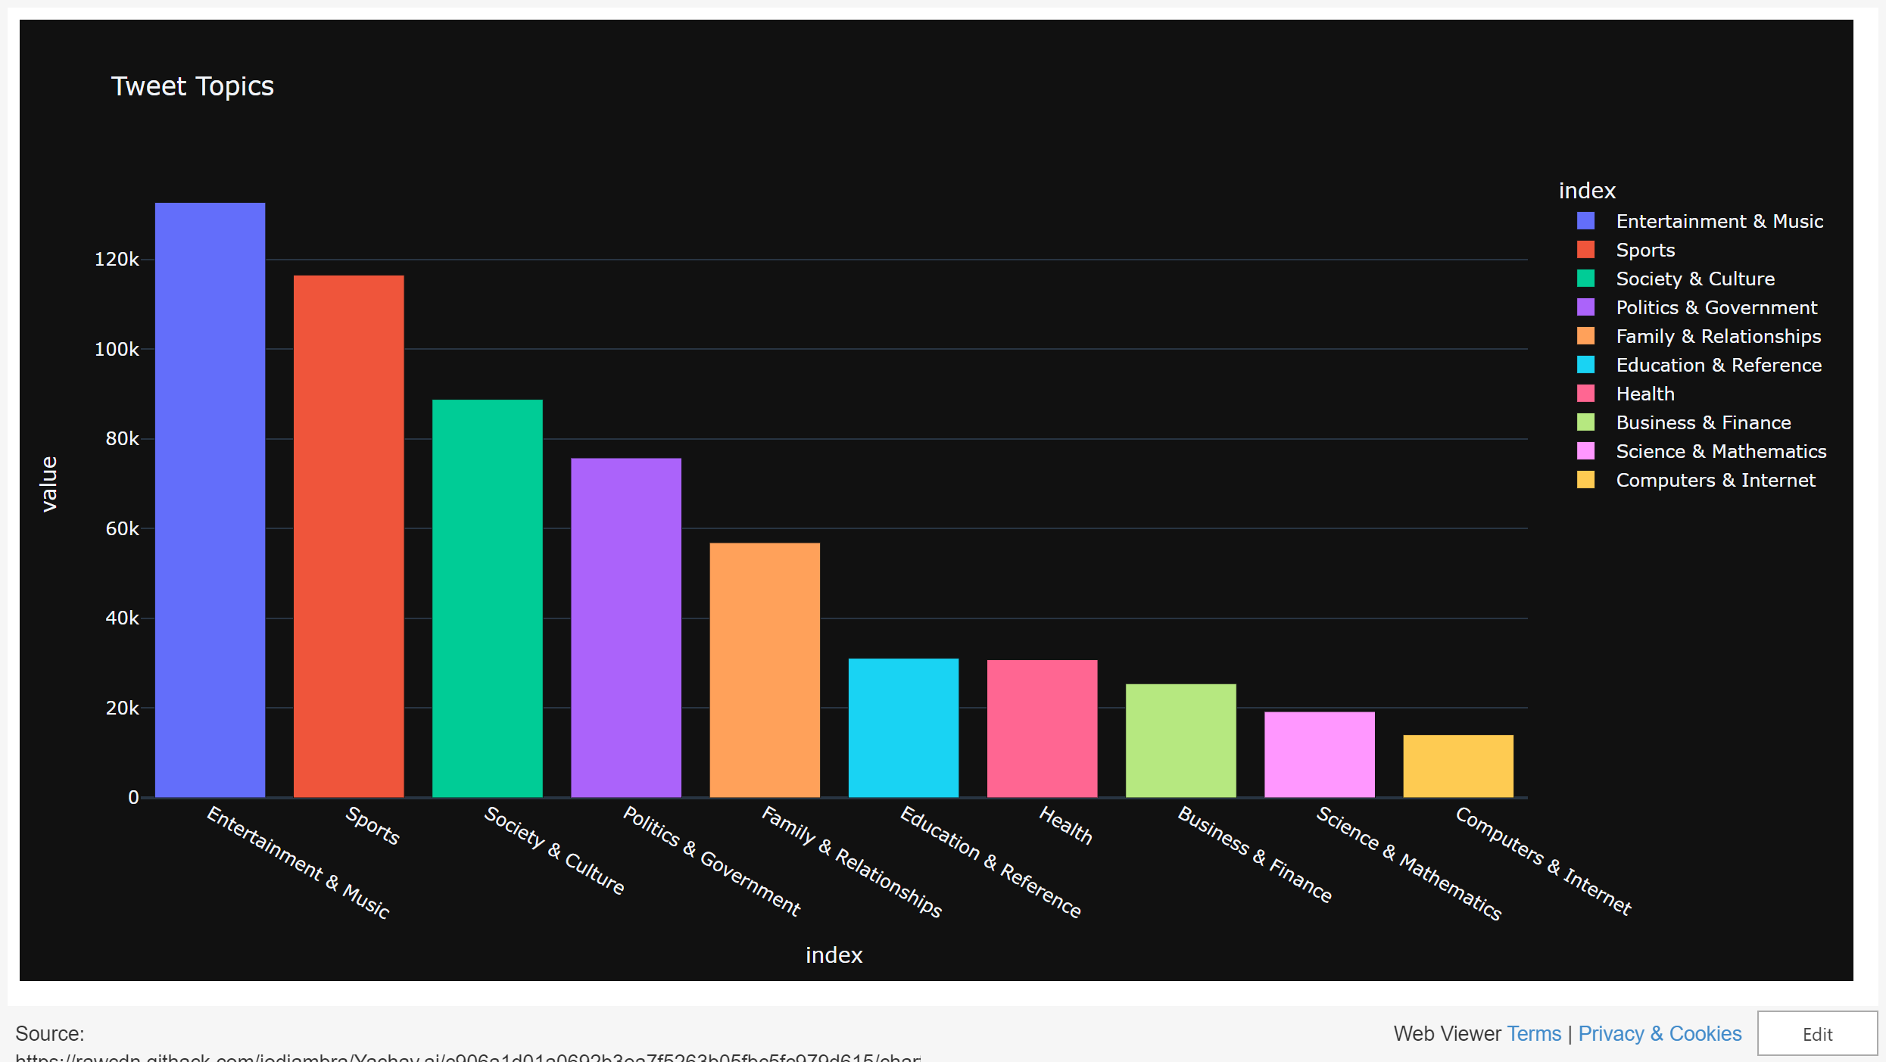

Slide 12
Flow Chart
Preprocess Text For Embeddings
1
Hugging Face Model
Concatenate Features
2
Text and Time Features
Feed Into MENET
3
4 Branches
1024 columns
1024 + 14 columns
Embeddings
User ID
Time features
Text features

Slide 13
Neural Network
Architecture and Hyperparameters

Slide 14
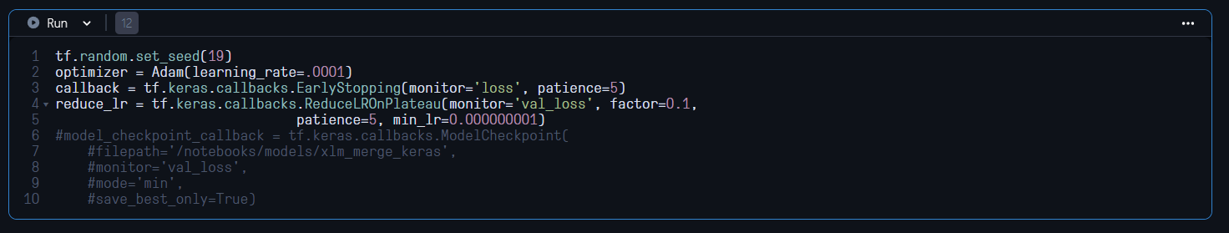
Neural Network Specifications

Slide 15
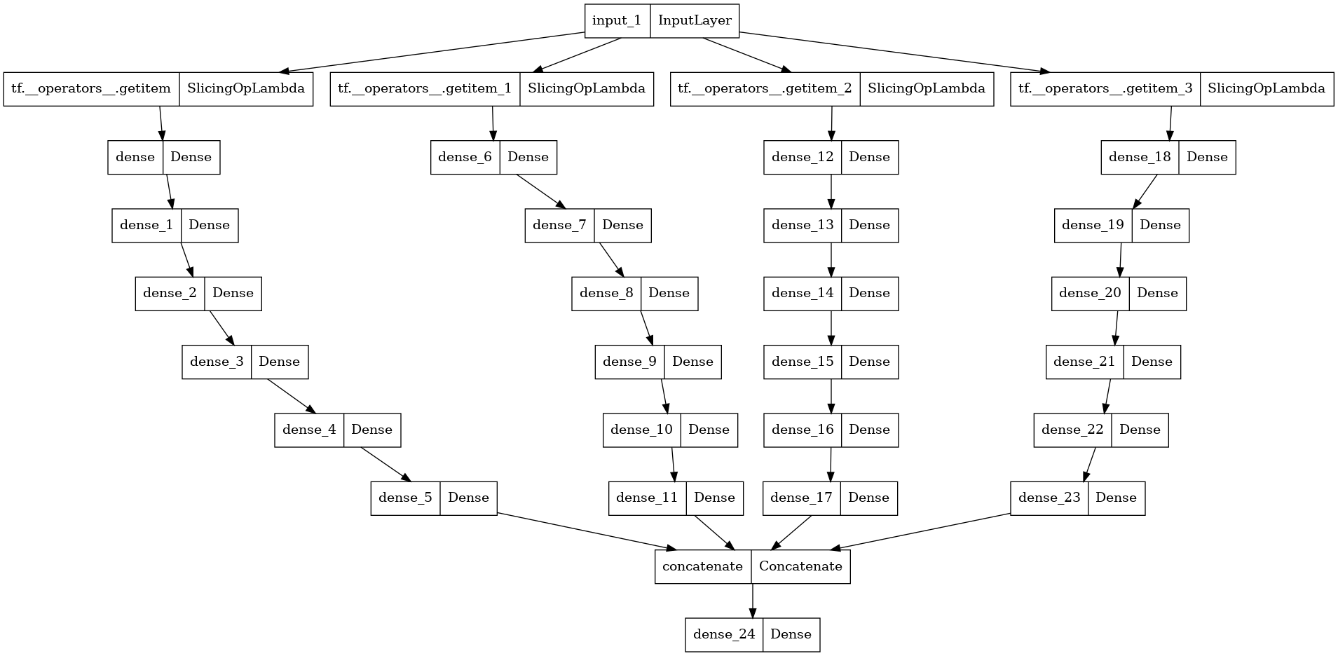
MENET Architecture
Notes:
Multiple Entry neural network

Slide 16
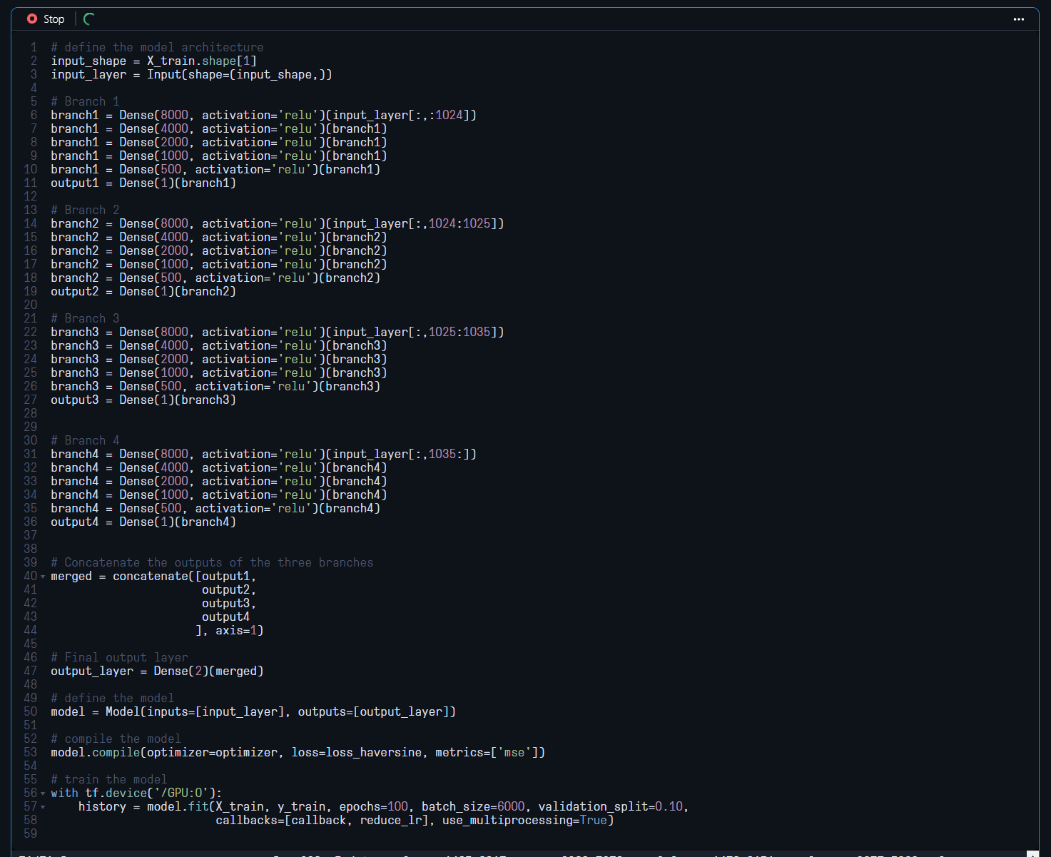

Slide 17
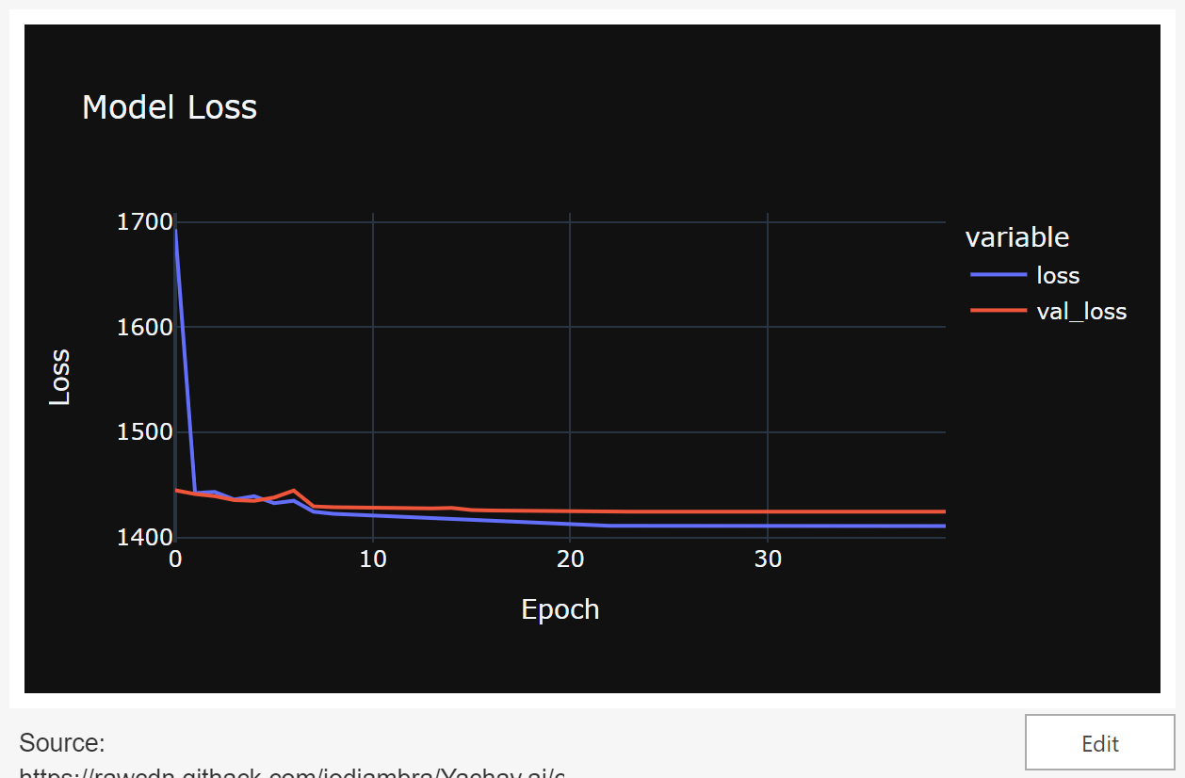
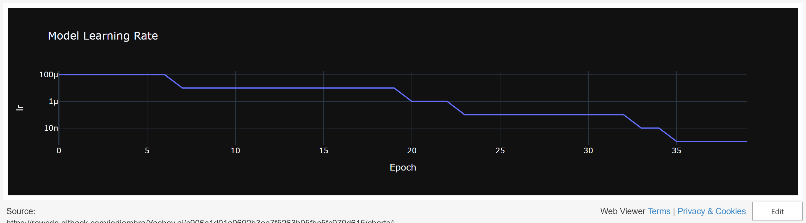
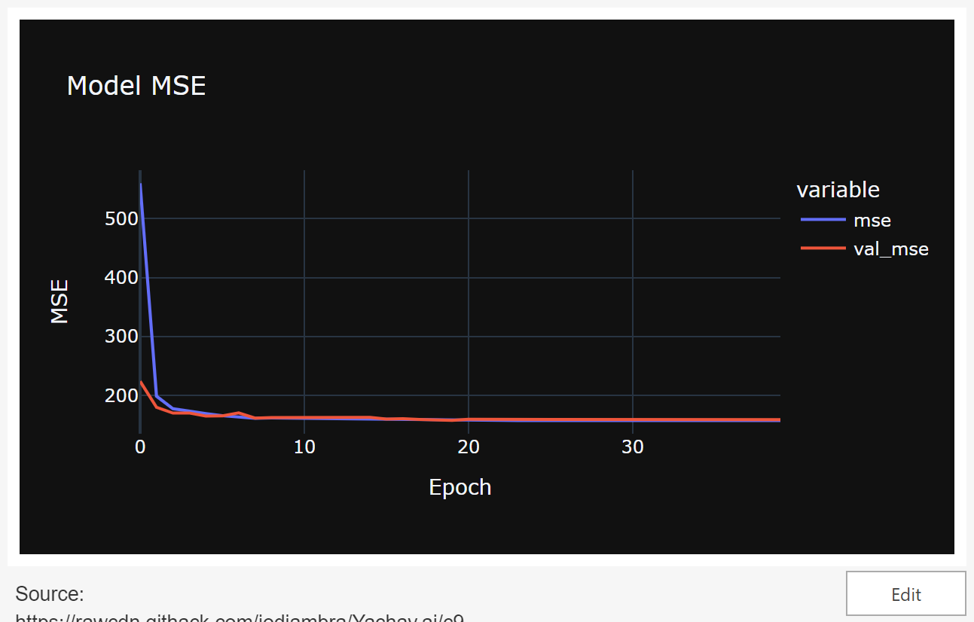

Slide 18
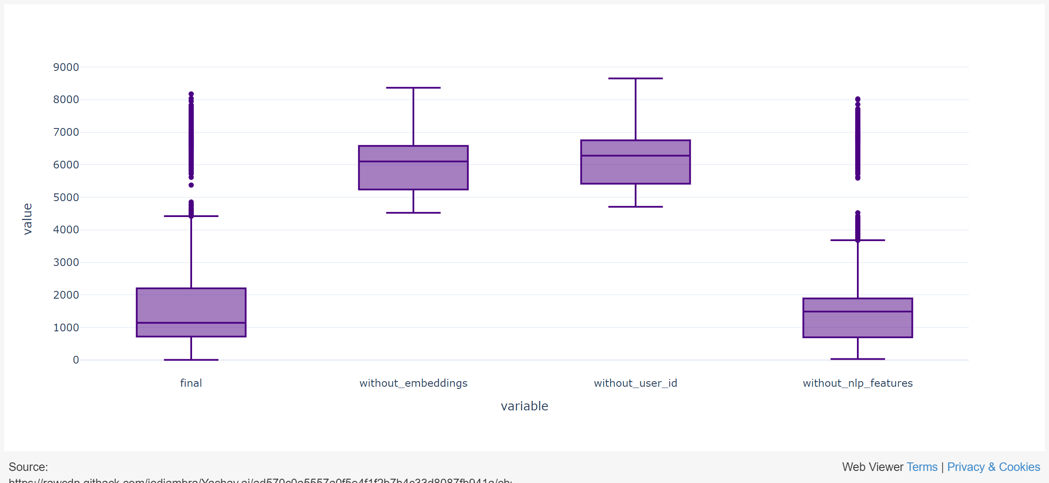
Distances Metric

Slide 19

Summary
Used Hugging Face pre-trained models to extract features from tweets, including sentiment, language, and topic.
The MENET architecture was used to learn from incomplete and noisy data and predict latitude and longitude.
Results on the test set showed a loss of 1414 km and an MSE of 158, with time features being the most important for the model's performance.
Further hyperparameter tuning, another NER pipeline, and more data per user could improve the model's accuracy.

Slide 20
Resources
Duong-Trung et al. An Effective Approach for Geolocation Prediction in Twitter Streams Using Clustering Based Discretization
Wagenseller et al. Location Prediction with Communities in User Ego-Net in Social Media
Do et al. Multiview Deep Learning for Predicting Twitter Users’ Location
Lutsai et al. Predicting the Geolocation of Tweets Using BERT-Based Models Trained on Customized Data
Lourentzou et al. Text-based Geolocation Prediction of Social Media Users with Neural Networks

Slide 21

Thank You
Jacques Diambra Odi
Github Repo
Project Notebook
Portfolio
Website

Slide 22
APPENDIX

Slide 23
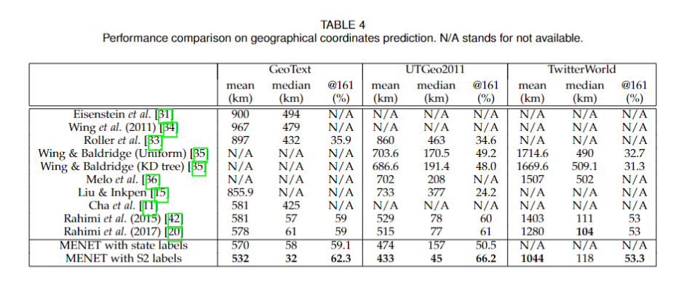
Literature Comparisons

Slide 24
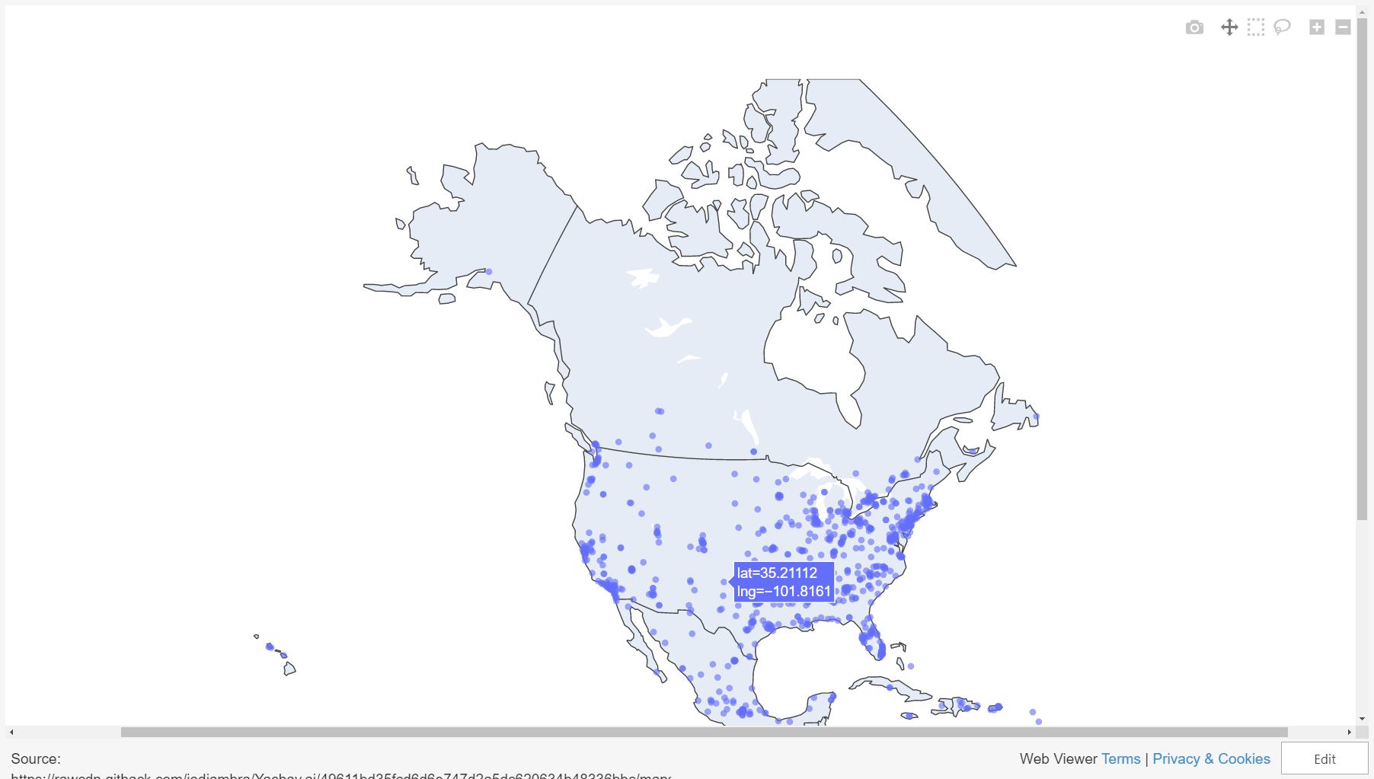

Slide 25
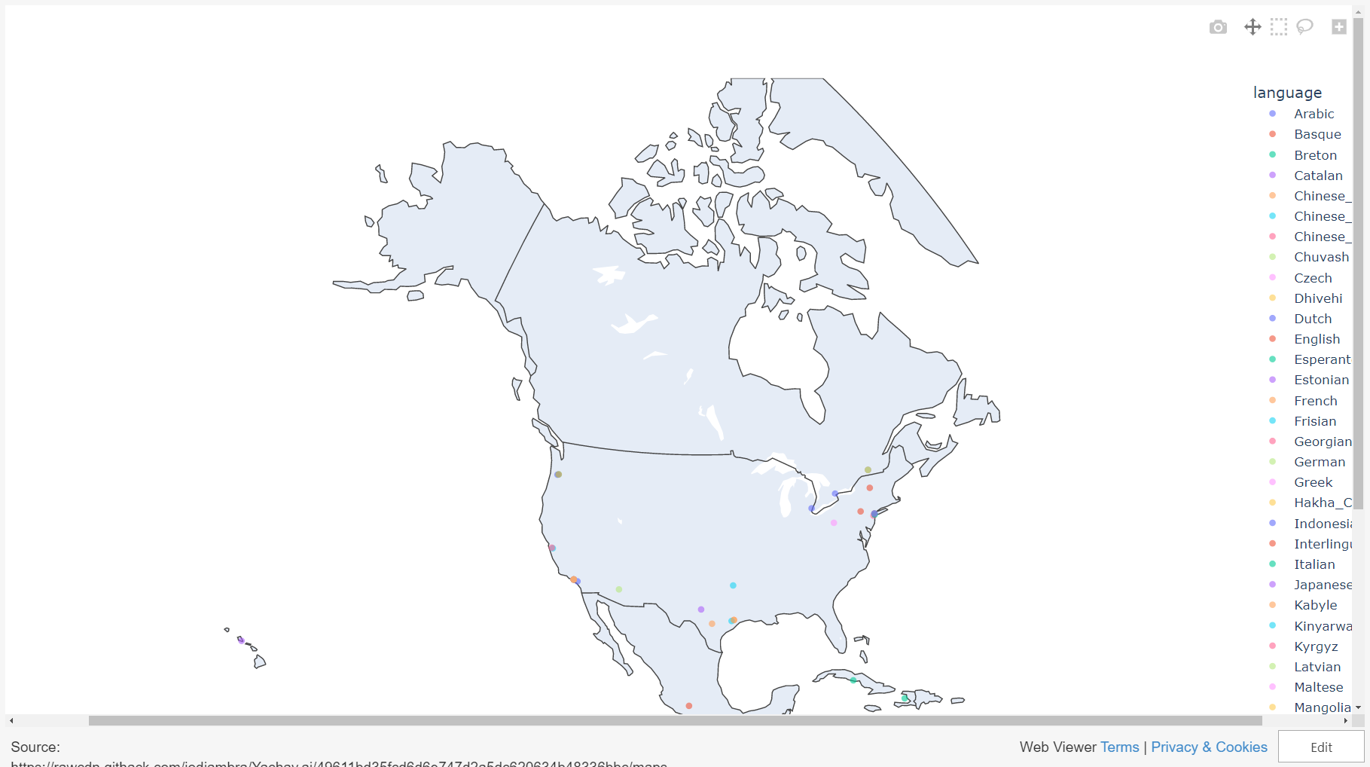

Slide 26
